Slide 1
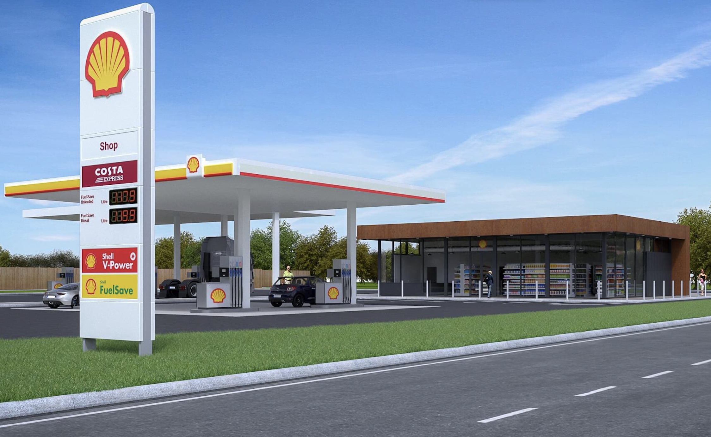


Roadside & TRICS:
Key Considerations for Users
Gavin Snowball & Dr Jordan Bell
Dynamic Transport Planning
TRICS Training and Development Forum – Edinburgh 2024
DYNAMIC TRANSPORT PLANNING
enquiries@dynamictransportplanning.co.uk
www.dynamictransportplanning.co.uk

Slide 2


HELLO!
What is Roadside?
GAVIN SNOWBALL
DIRECTOR
Using TRICS for Roadside
DR JORDAN BELL
Trip Type Surveys
SENIOR PROJECT
MANAGER
Roadside
TRICS
Trip Types
Notes:
GS: short intro to DTP background, himself
JB: Himself

Slide 3
ABOUT YOU
HANDS UP IF YOU ARE:
A Private Consultant?
A Local Authority Member?
Other TRICS User?
Roadside
TRICS
Trip Types

Slide 4

WHAT IS ROADSIDE?

Slide 5

QUESTION TIME
HANDS UP:
Have you been involved in Roadside related projects?
Are you aware of what a Roadside Land Use is?
Roadside
TRICS
Trip Types

Slide 6

WHAT IS ROADSIDE?
ROADSIDE USES:
A group of land-uses positioned within close proximity to areas of high volumes of traffic to draw upon road users.
Roadside uses vary in size and standard, with examples including:
Motorway Service Areas
Petrol Filling Stations
Drive Thru Restaurants
Drive Thru Coffee Shops
Roadside
TRICS
Trip Types
Notes:
MSAs: roadside hotels/motels also found at TRSAs could be considered roadside.
Rest areas and truckstops also included on the Motorway network

Slide 7
USING TRICS FOR
ROADSIDE

Slide 8
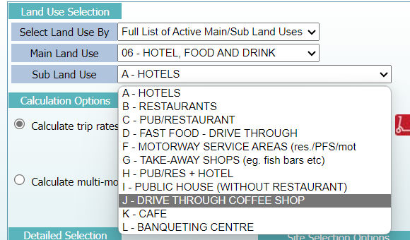
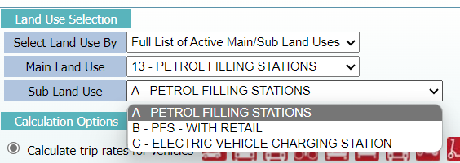
TRICS
DERIVING TRIP RATES
?
Roadside
TRICS
Trip Types
Notes:
EV Charging stations, future surveys, interested to see this data
EV bays won’t exceed around 3 trips per hour (typical trip rate of 1), longer dwell time but lower trips than PFS

Slide 9
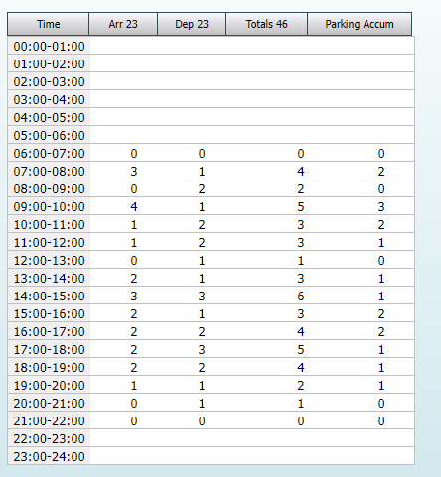
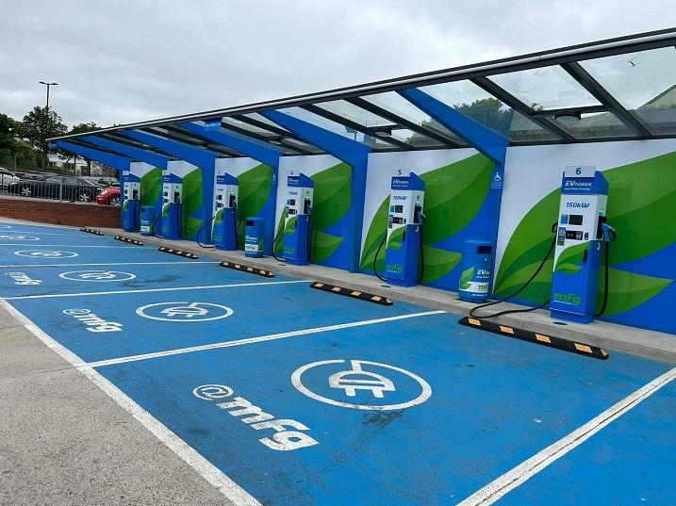
TRICS
EV CHARGING VERSUS PFS
New land use in the TRICS database with 1 surveyed site
A peak hour trip rate of 0.750 two-way
EV bays don’t typically exceed 3 trips per hour
Longer dwell time but lower trips than PFS
Roadside
TRICS
Trip Types
Notes:
EV Charging stations, future surveys, interested to see this data
EV bays won’t exceed around 3 trips per hour (typical trip rate of 1), longer dwell time but lower trips than PFS

Slide 10
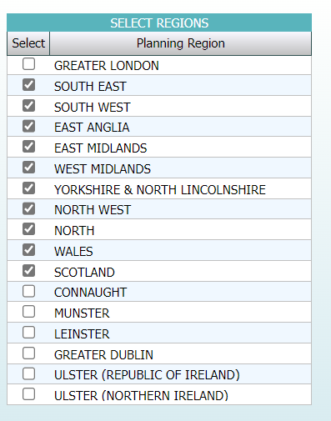
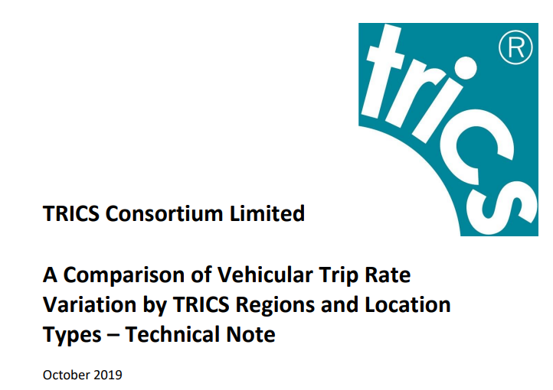
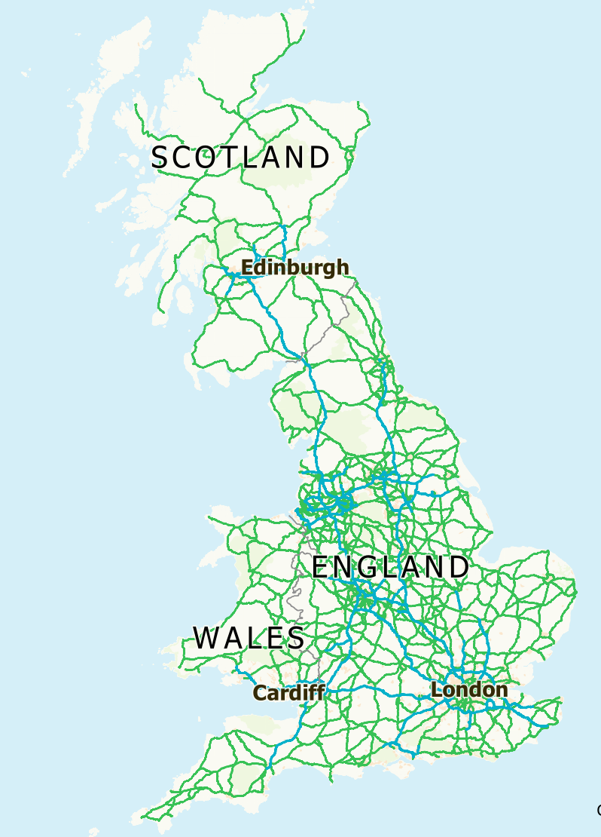
TRICS
SELECTING REGIONS
No clear evidence to exclude solely based on region.
Local factors should be assessed e.g:
Location type
Public transport
Accessibility
Roadside
TRICS
Trip Types
Notes:
Typical PFS in County Durham, near the DTP head office
We would look to exclude Greater London, based on all three of those factors
Ireland, different country, different rules/regulations – open up to dialogue with floor?

Slide 11
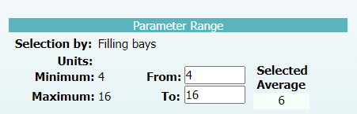
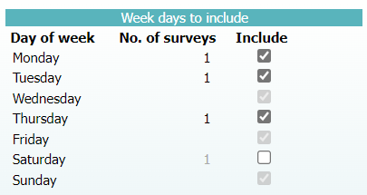
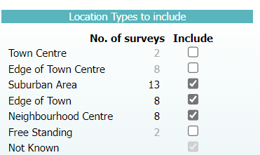
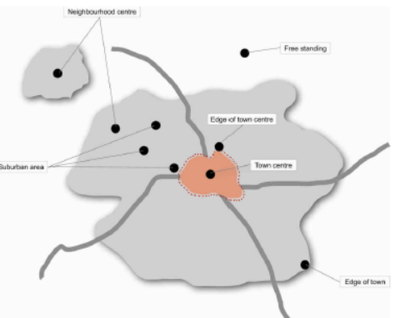

TRICS
PRIMARY FILTERING
Roadside
TRICS
Trip Types
Notes:
Try to get the average number of filling bays near to what is proposed
Weekday/Saturday only for comparisons, as peaks don’t match up
Default TRICS range for dates – subject to returning enough.
Exclude the areas not comparable, but you need the broadest source of comparator sites. Filter down too many and you don’t have a good comparison. ½ sites have a strong influence on your findings. 6+ a reasonable sample/average.
Trade off between things such as date range / location types questions validity of data but comfort in the result?

Slide 12
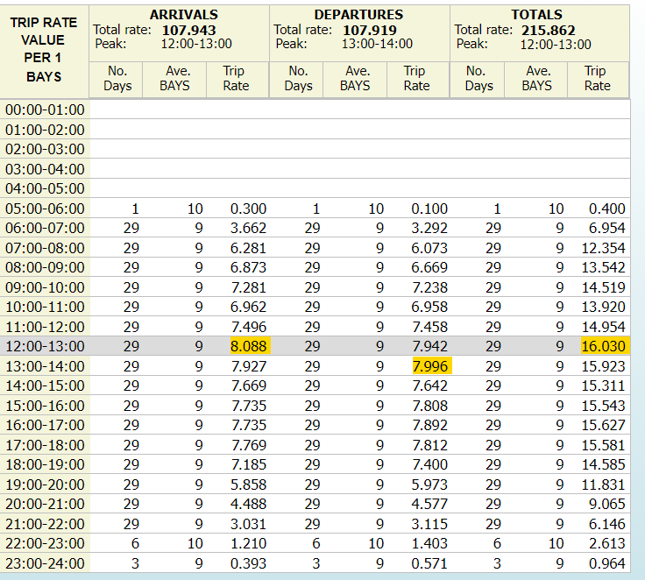
TRICS
TRIP RATES
Roadside
TRICS
Trip Types
Notes:
Actual peak is lunchtime
Busiest times on the highway network are AM/PM peaks
When assessing this, you would typically assess the busiest combined hours between the highway and development. Development itself is a low level generator of trips, so the highway peaks are taken. Dependent on location, e.g retail/leisure area versus business park.

Slide 13

TRICS
TRIP GENERATION
Time Period | Arrivals | Departures | Total
AM Peak | 55 | 53 | 108
MID Peak | 65 | 64 | 129
PM Peak | 62 | 62 | 124
Daily Total | 864 | 863 | 1727
8-bay Petrol Filling Station
Roadside
TRICS
Trip Types
Notes:
Is the number of bays relevant to the number of trips?
This is how we filter on TRICS, but it should be considered about other factors such as passing traffic, brand/price, competition and population density. This is all to be considered after deriving trip rates.

Slide 14
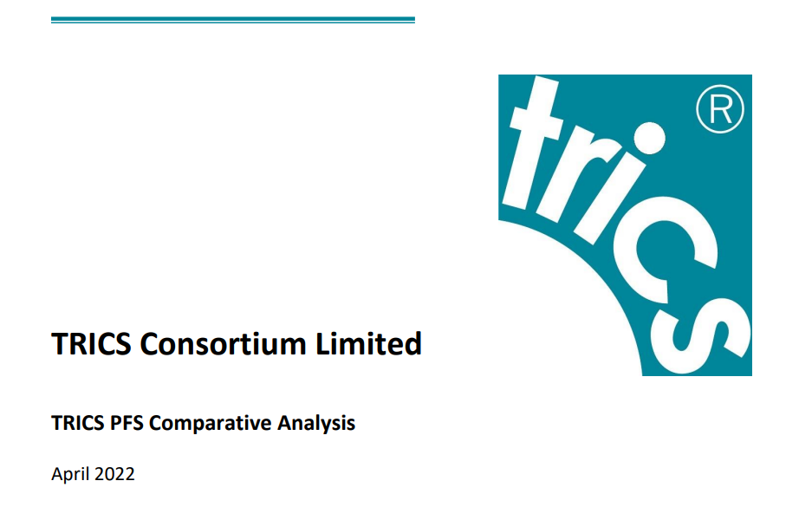
TRICS
Roadside
TRICS
Trip Types
Notes:
Majority of sites PFS with Retail
Higher trip rates in PFS with Retail than without retail
Very few PFS without retail sites (there will still be a retail offering, but small enough not to generate any trips on its own)

Slide 15


TRICS
THE BATTLE OF THE DRIVE THRU
COFFEE vs FAST FOOD
Roadside
TRICS
Trip Types

Slide 16
TRICS
THE BATTLE OF THE DRIVE THRU
COFFEE vs FAST FOOD
Two-way vehicle trips
Roadside
TRICS
Trip Types
Notes:
FF follows three mealtime peaks
Coffee morning peak, higher than any FF, but then tails off
HOWEVER, when looking at TRs per GFA, Coffee are usually considerably smaller than FFDT.
Definite differences, a more recent land use category in TRICS, previous assessments used FFDT for any drive thru developments.

Slide 17
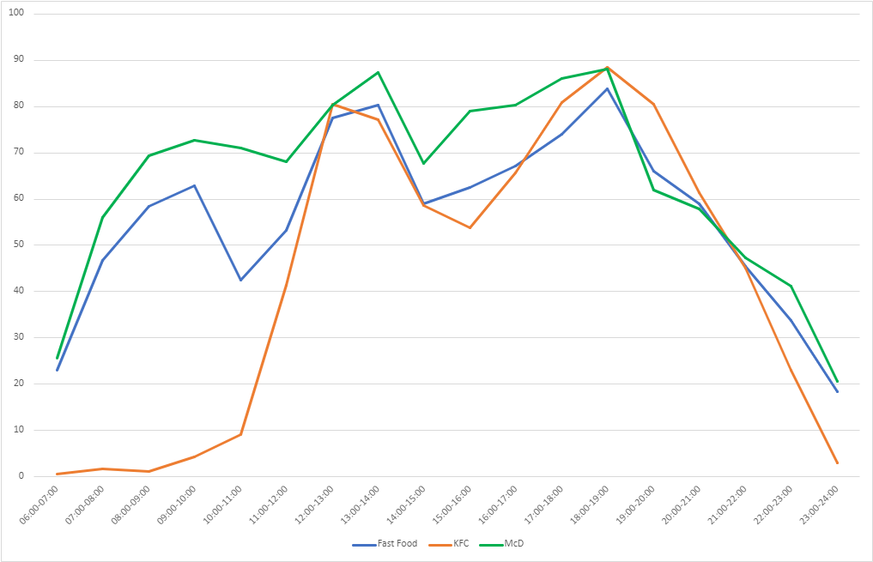
TRICS
THE IMPACT OF BRAND…..
Not a ‘Planning’ matter?
What is the impact on TRIP RATES?
Roadside
TRICS
Trip Types
Notes:
MCds follows the traditional FF trend, but is generally busier, so its bringing that TR up
For example, if you are looking at a KFC, there is no breakfast and its generally lower through the day
Although brand isn’t a planning matter there a fundamental differences within this land use

Slide 18
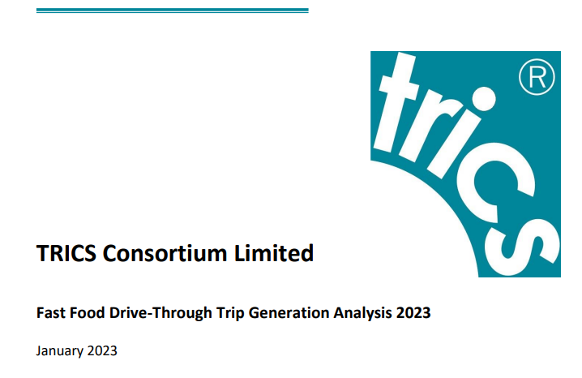
TRICS
TRICS Fast Food Drive Through Analysis (2023)
Comparison of trip generation between 2000-2011 and 2012-2022
Weekends were busier than weekdays, but by a greater margin in 2012-2022 (76.1%) than 2000-2011 (46.5%)
Total two-way weekday trip rate now 36.6% higher
Total two-way weekend trip rate now 64.2% higher
Roadside
TRICS
Trip Types

Slide 19
TRICS
THE IMPORTANCE & BENEFITS OF USING TRICS
Comprehensive database of comparative sites across multiple regions
Derive an average trip rate to be applied to specific land uses and specific quantum of development
Provides an essential baseline from which further assessment and analysis can be undertaken
Roadside
TRICS
Trip Types
Notes:
We are aware that for McDs apps, they use their own data not TRICS, is this handpicking?
Analysis shows this may be more robust
BUT they are not applying for brand! Planning element of Transport Planning? GS

Slide 20
TRIP TYPES

Slide 21
QUESTION TIME
HANDS UP:
Have you recently visited a Roadside drive-thru unit?
Did you:
Also fill up with fuel?
Did you:
Enter an adjacent retail store?
Roadside
TRICS
Trip Types
Notes:
Further question: on your last visit was the purpose solely to go to the DT or were you part of another trip?

Slide 22
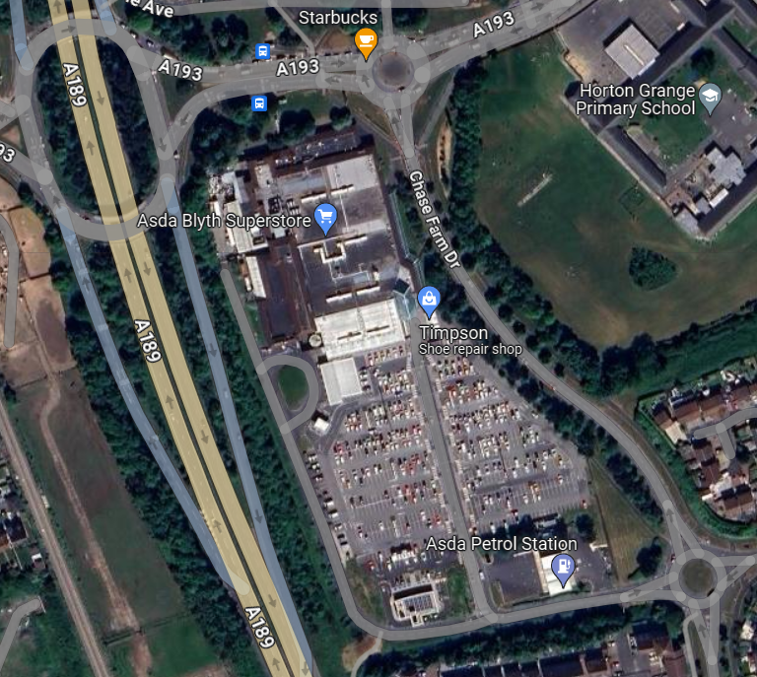


TRIP TYPES
TRIP TYPE SURVEYS
ASDA Blyth
Adjacent to A189 / A193, Blyth, Northumberland
ASDA Retail Store with drive-thru coffee shop and PFS
  Survey undertaken of Drive Thru Coffee Shop
  Determining number of vehicle trips and the type of trip undertaken
Roadside
TRICS
Trip Types
Notes:
DTP have undertaken some trip type surveys, here are some mixed use locations we surveyed

Slide 23
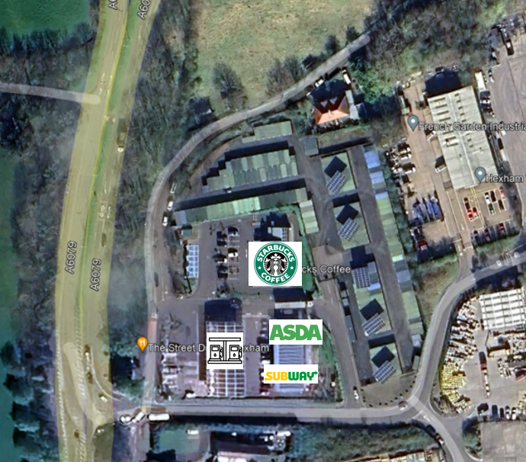
TRIP TYPES
TRIP TYPE SURVEYS
ASDA Express HEXHAM
Adjacent to A6879, Hexham
ASDA Express Store with drive-thru coffee shop and Subway unit
  Survey undertaken of Drive Thru Coffee Shop
  Determining number of vehicle trips and the type of trip undertaken
Roadside
TRICS
Trip Types

Slide 24
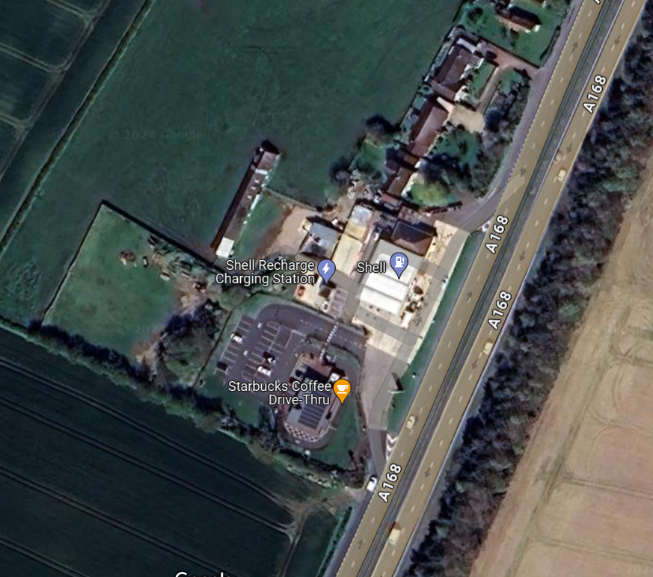
TRIP TYPES
TRIP TYPE SURVEYS
Thirsk A168 North Services
Adjacent to A168 Northbound
Drive thru coffee shop and PFS
  Survey undertaken of Drive Thru Coffee Shop
  Determining number of vehicle trips and the type of trip undertaken
Roadside
TRICS
Trip Types

Slide 25
TRIP TYPES
TRIP TYPE SURVEY RESULTS
Roadside
TRICS
Trip Types
Notes:
Both located on A roads, so the high pass by trip type makes sense
Few new trips, but more in Hexham, as this is in a more retail area. Halfway between roadside/town center
Thirsk site is a services so no divert.

Slide 26
TRIP TYPES
TRIP TYPE SURVEY RESULTS
KEY FINDINGS
Around half of all vehicle trips to drive-thru sites make use of only the drive-thru lane
These trips do not add to the parking demand of the site
This is typical of other data collected from drive-thru coffee shops, showing around 50% use the drive thru lane
Number of vehicles solely using the drive-thru lane
Roadside
TRICS
Trip Types

Slide 27
TRIP TYPES
TRIP TYPE SURVEY RESULTS
ASDA BLYTH
ASDA Linked – 28%
Vehicles already visiting the site to make use of the adjacent retail stores
Access Pass-By – 19%
Vehicles already on the local highway networking routing past the site
Diverted – 32%
Vehicles already on the local highway network, changing route to visit the site
New – 21%
Vehicles solely driving to and from the site with no other purpose
Roadside
TRICS
Trip Types
Notes:
Key point is that there are very few new trips across any of the surveys

Slide 28
TRIP TYPES
TRIP TYPE DISCUSSION
Only around 20% of the trips derived from the TRICS analysis are actually ‘new’ to the highway network
Roadside developments draw upon passing traffic for trade, evidenced by pass-by and diverted trips
When roadside type sites are located within a retail area, a significant portion of the trips are linked across the site
Roadside
TRICS
Trip Types

Slide 29
DYNAMIC TRANSPORT PLANNING
enquiries@dynamictransportplanning.co.uk
@DynamicTP
www.dynamictransportplanning.co.uk

